Slide 1
Analysis of human Language
Vicki Ziwei zheng

Slide 2
NLP
Natural language processing (NLP)
a subfield of computer science, information engineering, and artificial intelligence concerned with the interactions between computers and human (natural) languages, in particular how to program computers to process and analyze large amounts of natural language data.

Slide 3
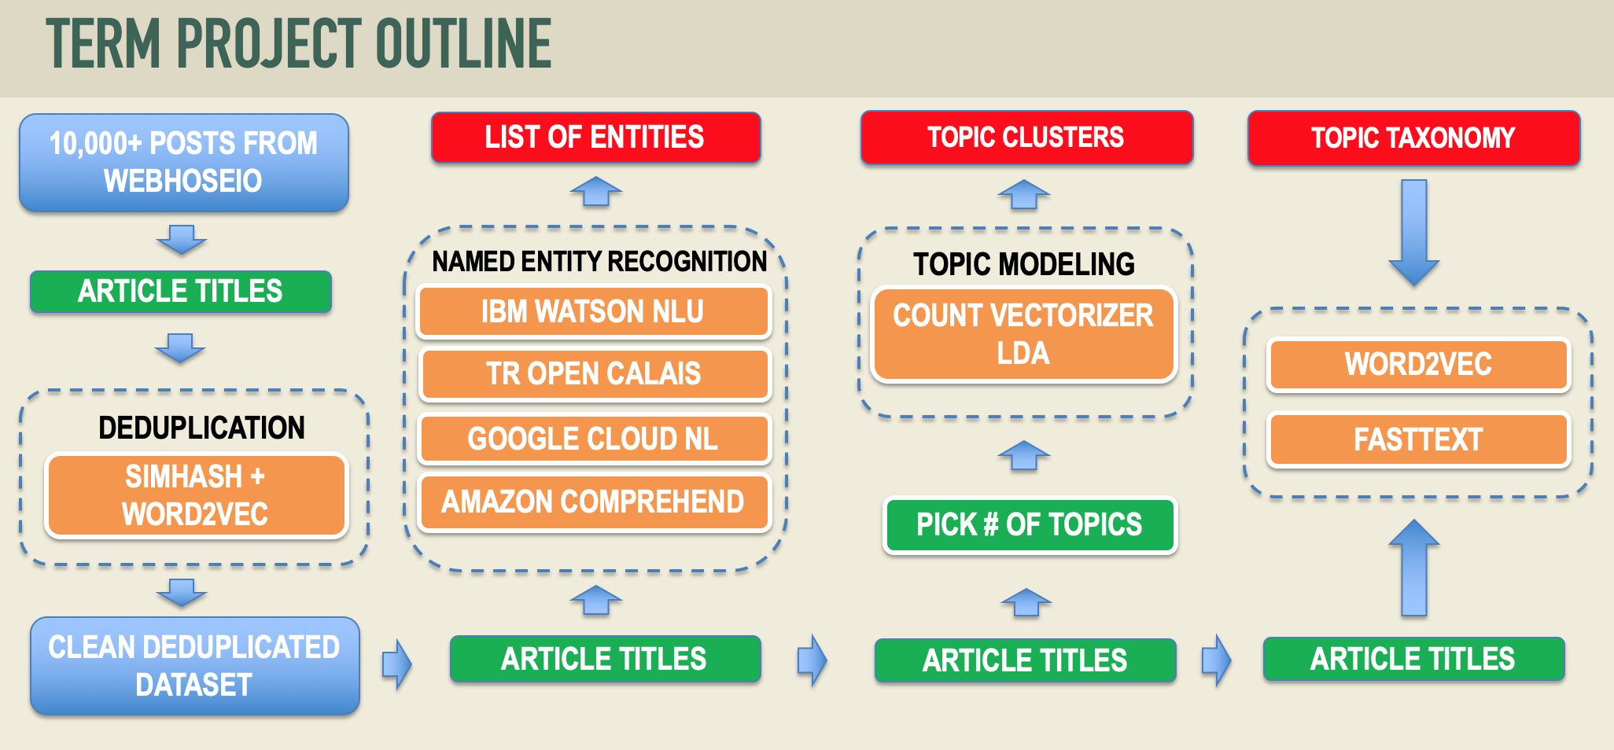
The webhose.io api provides easy to integrate, high quality data and meta-data, from hundreds of thousands of global online sources like blogs, reviews, news and more. Available by query based API.
Topic clusters are a collection of interlinked articles or pages around one umbrella topic. They ultimately allow you to provide greater visibility for search engines to identify your content.
A taxonomy is a model used to organize and index knowledge (stored as documents, articles, videos, etc.) so that users can find the information they are searching for.
Unsupervised
Supervised
Supervised
Named-entity recognition (NER) (also known as entity identification, entity chunking and entity extraction) is a subtask of information extraction that seeks to locate and classify named entity mentions in unstructured text into pre-defined categories such as the person names, organizations, locations, medical codes, time expressions, quantities, monetary values, percentages, etc.

Slide 5
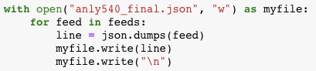
Get 10,000 posts
Crawled 10,000 posts from webhoseio using filters:
organization: google
Language: English
Date: 08/01/2018 – 12/01/2018
Got 8019 posts
Save as .json file
Result:
Still found other language articles – Need more filter processing
https://webhose.io/web-content-api

Slide 6
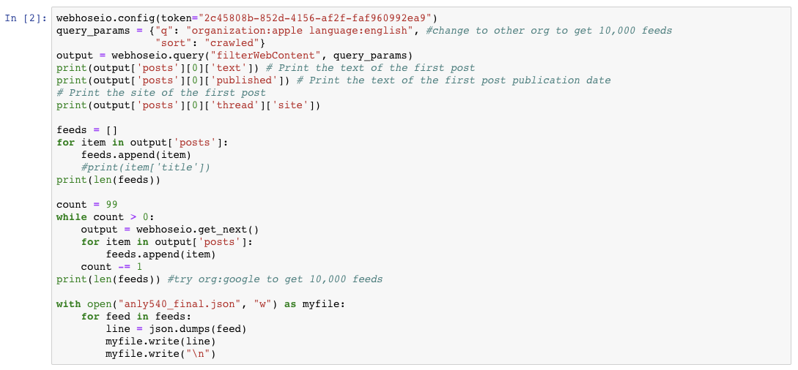
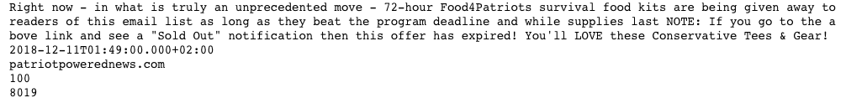

Slide 7


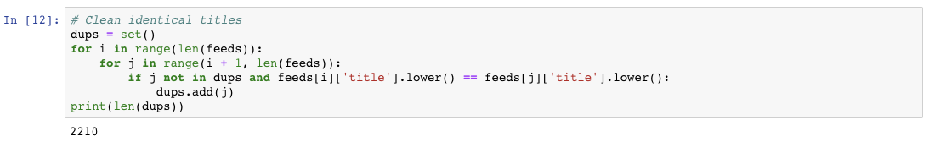
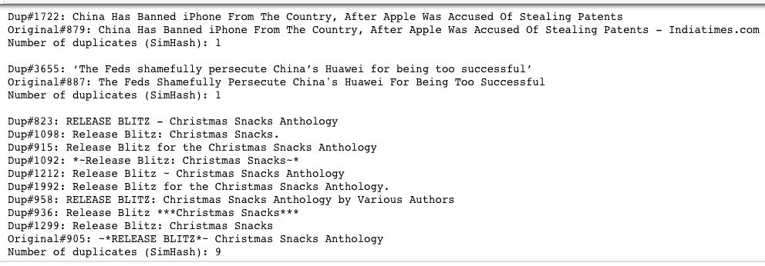
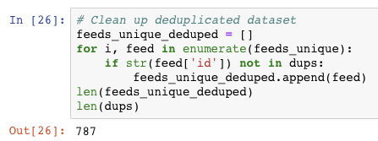
deduplication
Clean Dataset
1. clean 2210 identical titles
2. get unique titles
3. further clean using
Simhash
Wordvector
Distance = 8
4. Get 787 more similar titles cleaned

Slide 8
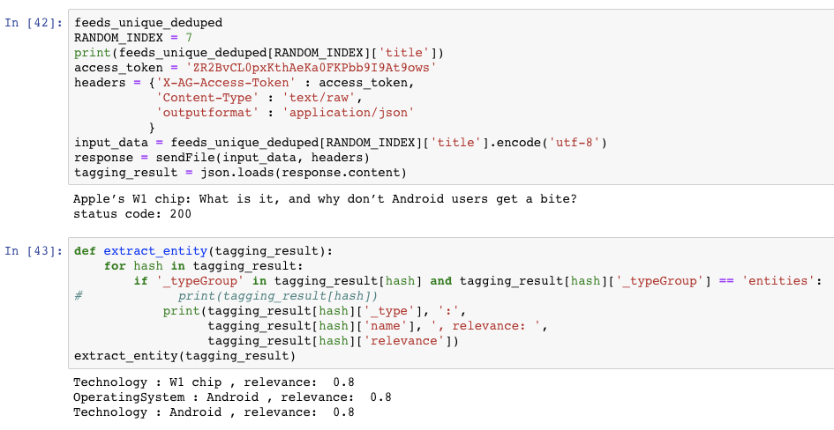
Named entity recognition
Tagging
Extract entity
Get relevance value

Slide 9
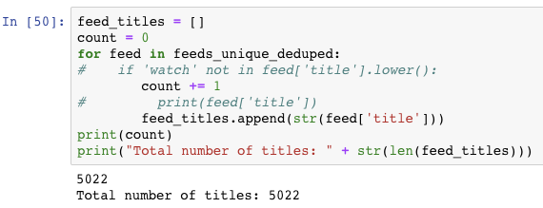
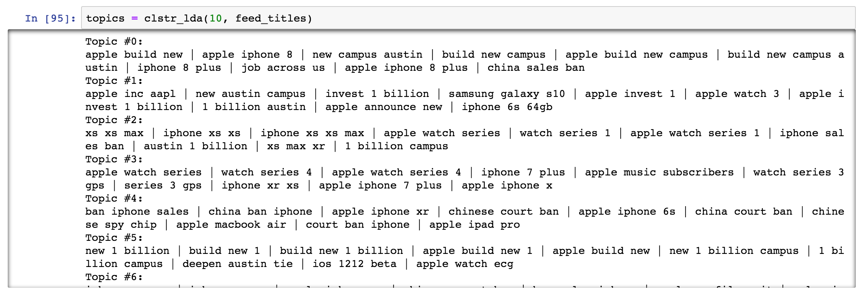
Topic modeling
Total number of titles from clean dataset: 5022
Clstr_LDA
We describe latent Dirichlet allocation (LDA), a generative probabilistic model for collections of discrete data such as text corpora. (Bayes Model)
Bayesian inference is a method of statistical inference in which Bayes' theorem is used to update the probability for a hypothesis as more evidence or information becomes available.
Topic Clustering
Result is not
so good.

Slide 10
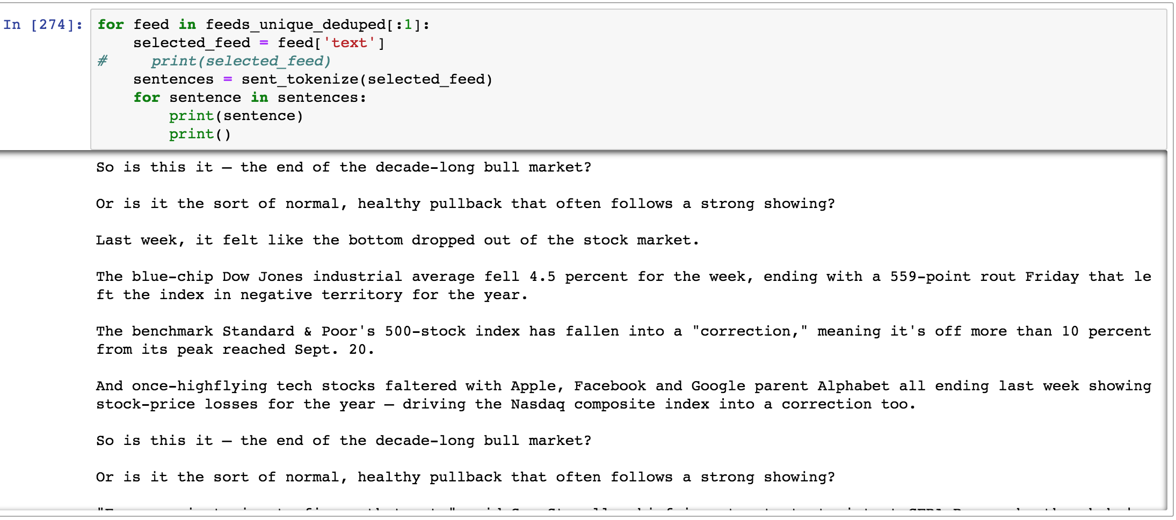
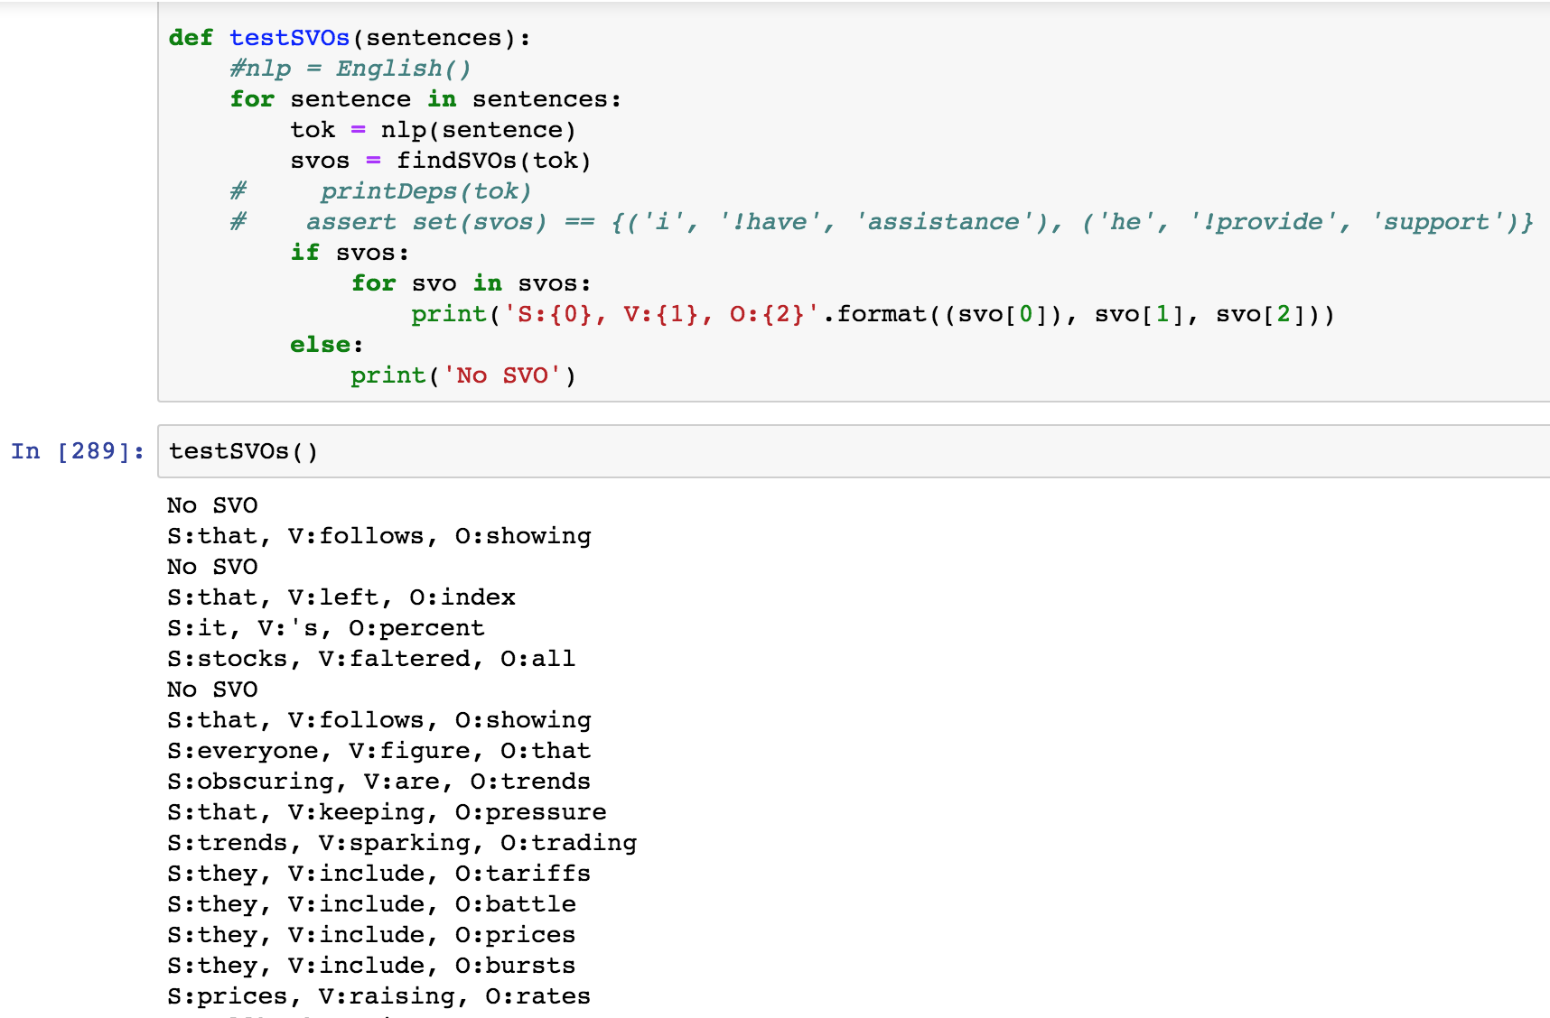
Content analysis example/unit test

Slide 11
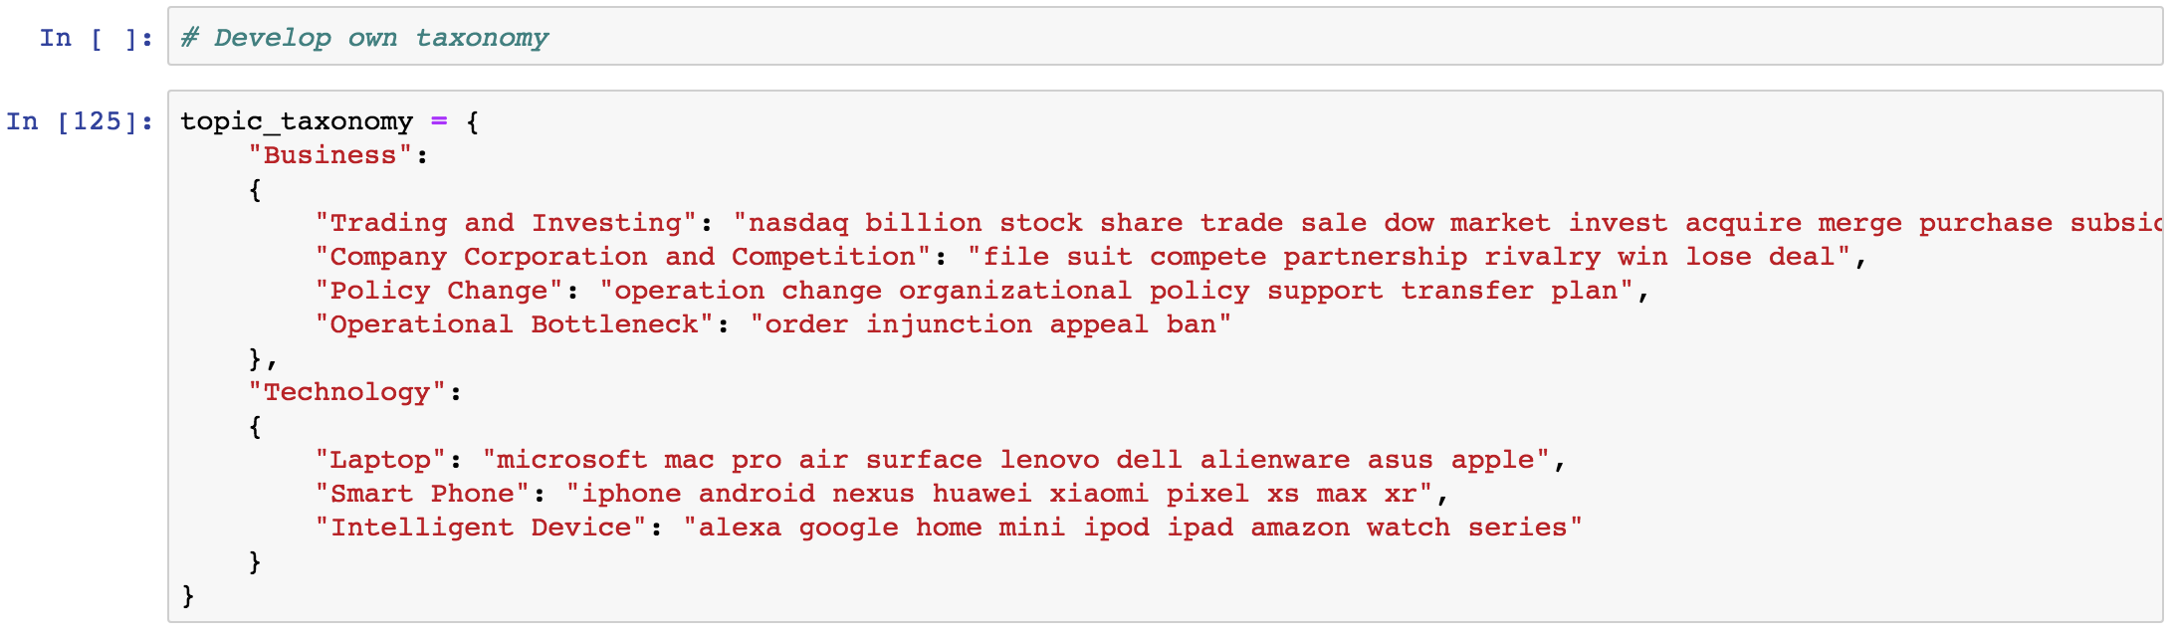
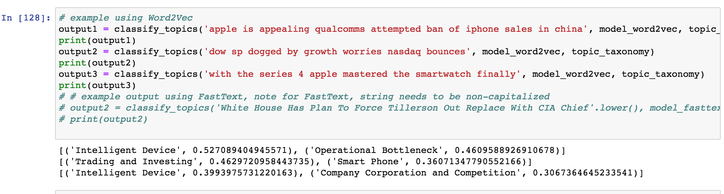
Topic taxonomy
What these revealed:
Apple shares keep falling in last three months
Apple watch wins more favorites
Apple is facing difficulties on expanding Chinese market
Testing and Finding:
How would below articles classified into Company Corporation and Competition：
‘China Bans Sale Of Multiple iPhone Models But Apple Is Not Giving Up Just Yet’ - Policy Change
‘Apple iPhone to Google Pixel 3: How to transfer contacts, messages, calendars and media‘, - Smart Phone
’Apple Shares Drop to Lowest in Over 3 Months on iPhone Suppliers‘ Warnings’ - Trading and Investing

Slide 12
Future improvement
Analyze on optimizing deduplication process time
Analyze on alternative algorithm for similarity calculation
Improve LDA model to get better cluster
Build better taxonomy
Use nltk to analyze entities

Slide 13
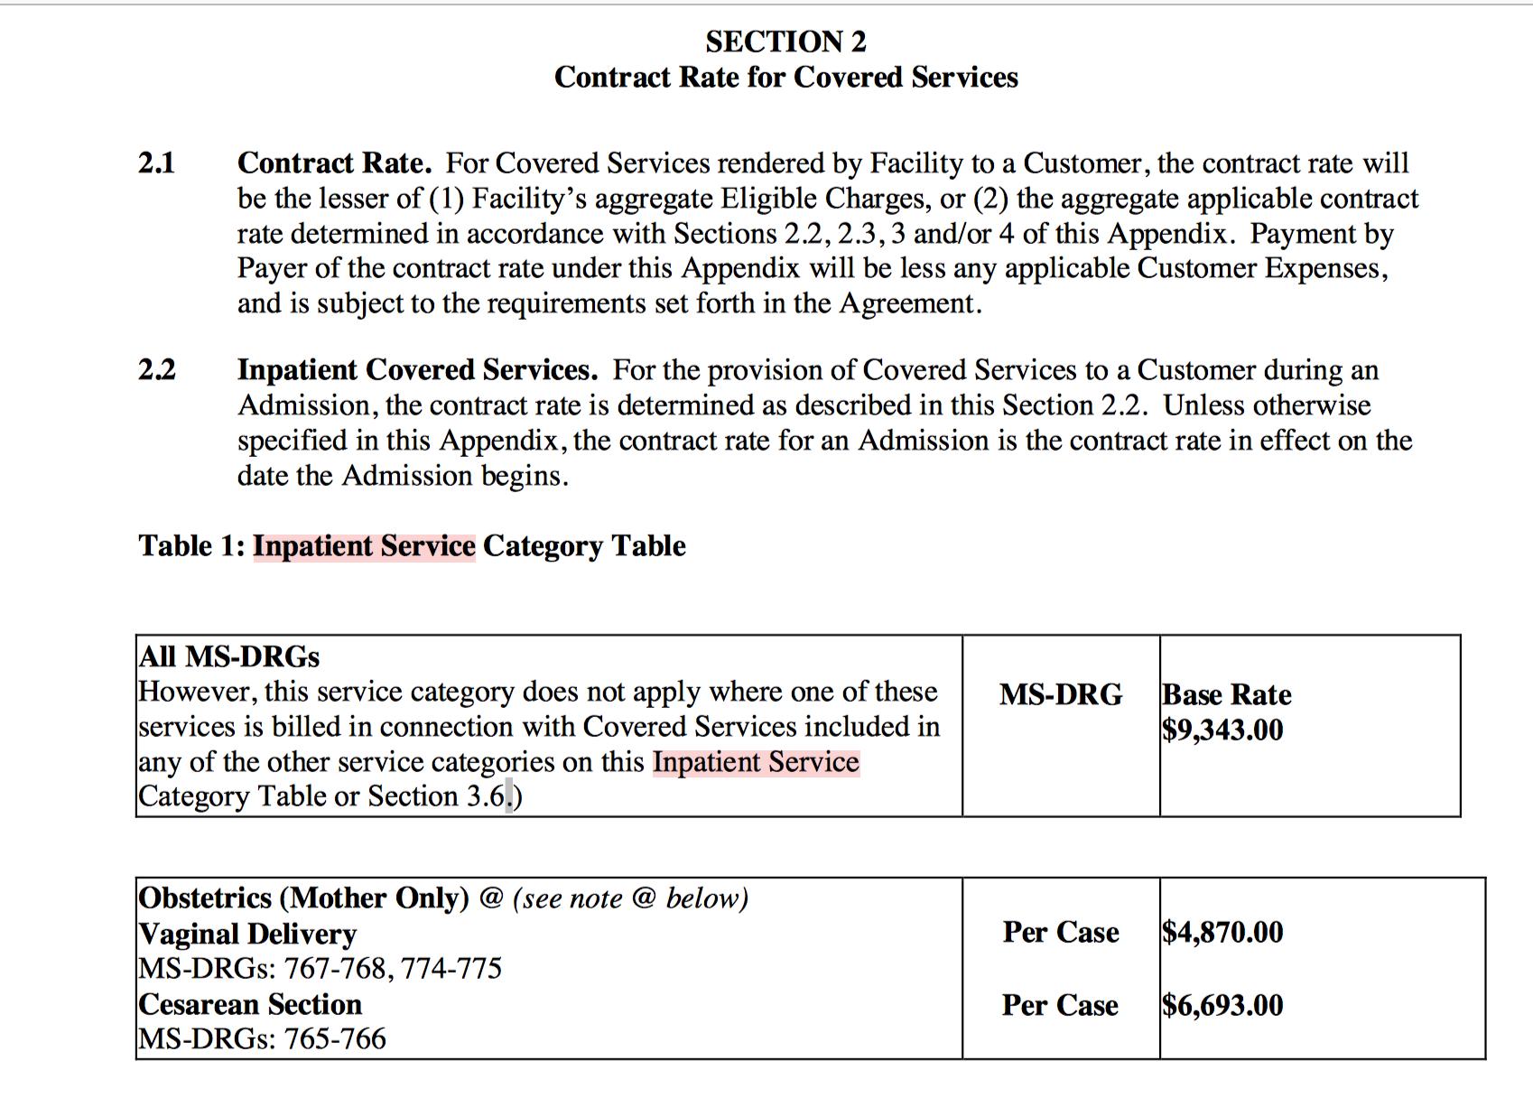
Problem PIC is facing
Unstructured contract text
Inconsistent contract layouts
Contract NLP analysis
Contract implementation with PIC

